Slide 1
BCOG 100
Pattern Recognition
Lecture 2: Pattern Recognition Algorithms

Slide 2
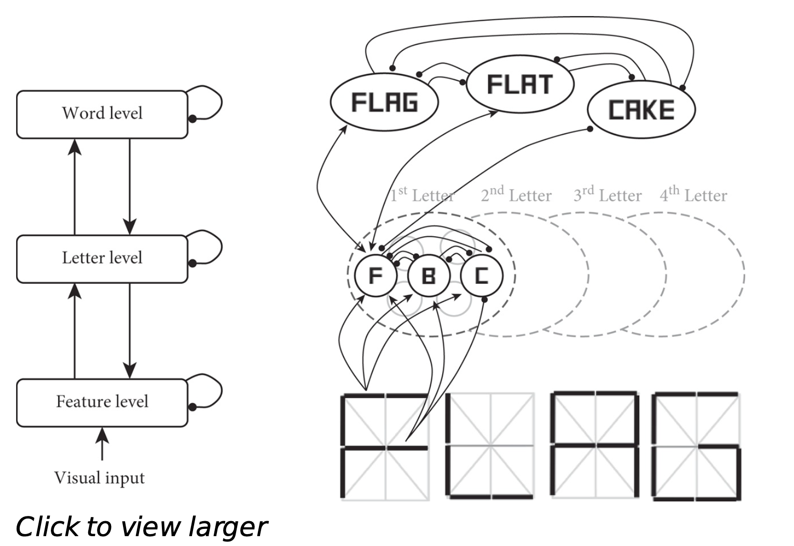
Reading Check 7-2
Password: ia
Question: Explain this figure

Slide 3
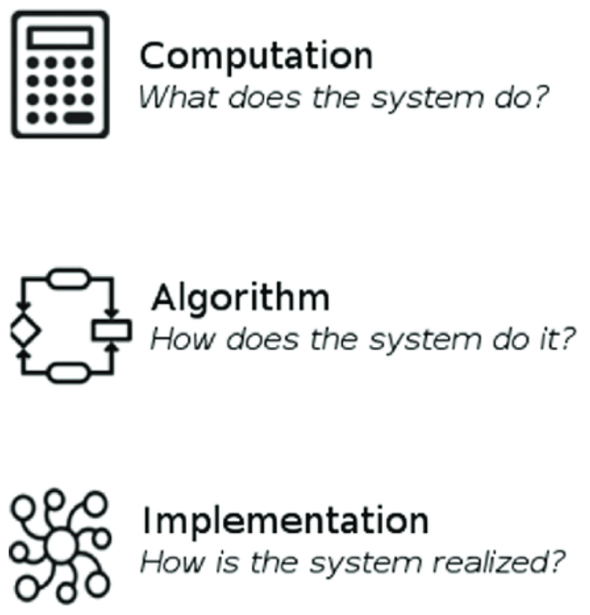
Pattern Recognition Algorithms
Recap & Overview
The problems of pattern recognition
Today:
How systems overcome these problems
What principles make recognition adaptive and robust
Notes:
Last time, we focused on the problem of pattern recognition.
We looked at the challenges any system faces when trying to extract meaning from noisy, overlapping, and constantly changing sensory data.
Today, we turn to the solutions.
We’ll look at how both biological and artificial systems learn to recognize patterns—and how the same core principles show up in evolution, psychology, and machine learning.
Our goal is to understand not just that these systems work, but why they work:
What kinds of representations, learning rules, and organizational principles make perception stable, flexible, and generalizable.
By the end of today, we should be able to see how these computational ideas—nonlinear mapping, hierarchy, distributed representation, and continual learning—fit together into a single story about how pattern recognition evolves and operates.

Slide 4
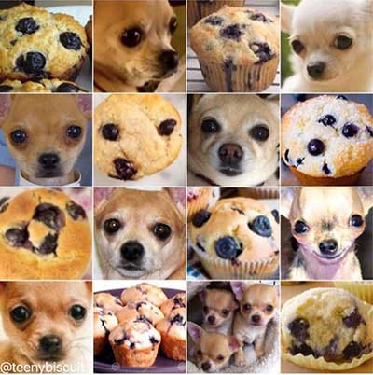
Pattern Recognition Algorithms
From Limits to Learning
Brains, behavior, and AI face similar challenges
Evolution, psychology, and ML found convergent solutions
Representation, abstraction, and learning over time
Notes:
All learning systems—whether brains, animals, or algorithms—face the same basic constraints.
They must extract regularities from a complex world, and use those regularities to guide behavior.
What’s striking is that evolution, psychology,
and modern AI have all converged on very similar solutions to these challenges.
Even though they started from different directions
—biology, experimentation, and computation—they arrived at overlapping principles.
Across these domains, success depends on a few key capacities.
The first is representation: finding a way to encode the important features of the environment.
The second is abstraction: learning stable structure that holds across variation.
And the third is learning over time: being able to update knowledge without erasing what came before.
Together, these principles form the backbone of every effective pattern recognition system
—whether it’s a human brain recognizing faces, a rat navigating a maze, or a neural network classifying images.

Slide 5
Pattern Recognition Algorithms
R1
R1
R1
R2
R2
R2
R3
R3
R3
Linearly Separable
XOR
Prototype
Linear Boundaries and Their Limits
Single-layer systems draw one boundary
Good for simple categories, not complex ones
Example: The exclusive OR problem
Notes:
Let’s start with the simplest kind of pattern recognition system: one that can only draw a single straight line in its feature space.
Imagine a circuit or a single-layer neural network that has to decide whether a stimulus belongs to category A or B.
If the categories can be separated by a single linear boundary
—say, bright versus dark, or odor A versus odor B—then this system can learn the task perfectly well.
It adjusts its weights to tilt the decision boundary until the two sets of inputs fall on opposite sides.
But many real-world categories don’t work this way.
Think about trying to classify “A or B but not both.”
No single straight line can separate that pattern—this is the classic “exclusive OR” or XOR problem.
The system simply doesn’t have enough flexibility.
So, linear systems can solve simple discrimination problems,
but they break down as soon as the categories are nonlinear, overlapping, or context-dependent.
And that’s where we need a new idea: hidden layers.

Slide 6
Pattern Recognition Algorithms
y
Nonlinear Solutions: Hidden Layers
Intermediate layers transform the feature space
Nonlinearity enables flexible separation
Similar logic appears in sensory systems
h1
h2
x1
x2
Notes:
The key insight of both biological and artificial neural networks
is that adding intermediate layers transforms what the system can represent.
These hidden layers sit between the raw inputs and the final outputs,
and they don’t just pass signals along—they re-represent the information.
Each hidden unit combines multiple inputs and applies a nonlinear activation function, like the sigmoid.
This allows the system to create new internal features that depend on combinations of inputs, rather than individual cues.
By transforming the input space in this way,
the network can turn a problem that was nonlinear and inseparable
into one that is linearly separable in the new space.
Essentially, hidden layers bend and stretch the feature space
until the categories fall on opposite sides of a simple decision boundary.
This is a profound shift.
It means that the network isn’t just memorizing patterns
—it’s constructing new dimensions of representation that capture the underlying structure of the world.

Slide 7
Pattern Recognition Algorithms
Hidden Layers as Geometry
Remapping inputs into a new latent space
Warping feature space until categories become separable
Hidden layers as learned coordinate transformations
0,1
1,1
h1
0,0
h2
1,0
Notes:
One way to understand what hidden layers do is through geometry.
Every input pattern can be thought of as a point in a high-dimensional space,
where each dimension corresponds to a feature.
In that original space, categories like “food” and “poison” might be hopelessly tangled
—no single plane can separate them cleanly.
The hidden layer acts like a geometric transformation,
warping this space so that those tangled clusters become linearly separable.
In other words, the hidden layer learns a new coordinate system
—one where the same complex categories can now be divided by a simple line.
It doesn’t memorize examples; it reshapes the underlying geometry so that generalization becomes possible.
This way of thinking connects to how sensory systems in the brain process input
—gradually transforming raw sensory data into more abstract, separable representations of the world.

Slide 8
Pattern Recognition Algorithms
Hidden Layers as Decision Boundaries
Each unit draws one linear cut in space
The output combines them into curved or disjoint regions
Complex boundaries built from many simple ones
0,1
1,1
x1
0,0
x2
1,0
Notes:
A third way to understand hidden layers is through their decision boundaries.
Each neuron, whether biological or artificial, effectively draws a single line
—or in higher dimensions, a plane—that divides its input space into two regions.
When you add a hidden layer, you add multiple such boundaries.
Each hidden unit defines its own slice of the space, and the output neuron then combines these slices
—sometimes adding them together, sometimes subtracting—to form a much more complex shape.
By piecing together many simple linear boundaries, the network can approximate any curved or disjoint decision region.
This is how a multilayer network can recognize nonlinear categories, such as “A or B but not both,”
or distinguish between overlapping clusters that a single line could never separate.
It’s a geometric way of seeing what hierarchical composition means in practice:
combining many simple discriminations to carve out a complex, structured space of categories.

Slide 9
Pattern Recognition Algorithms
Hidden Layers as Compositional Logic
Each unit performs a simple logical function
Combining layers composes clauses into complex rules
Networks implement compositional Boolean structure
x1
h1
y
x2
h2
XOR | Inputs
x1 | x2 | y
0 | 0 | 0
0 | 1 | 1
1 | 0 | 1
1 | 1 | 0
NOT AND | Inputs
x1 | x2 | h1
0 | 0 | 1
0 | 1 | 1
1 | 0 | 1
1 | 1 | 0
OR | Inputs
x1 | x2 | h2
0 | 0 | 0
0 | 1 | 1
1 | 0 | 1
1 | 1 | 1
AND | Inputs
h1 | h2 | y
1 | 0 | 0
1 | 1 | 1
1 | 1 | 1
0 | 1 | 0
Notes:
Another way to think about hidden layers is in terms of logic.
A single neuron can only compute the simplest logical relations—things like AND, OR, or NOT.
Those are linearly separable operations.
But by stacking neurons into layers, a network can compose these simple operations into more complex ones.
Each hidden unit implements one small logical clause,
and the output neuron combines those clauses into a higher-order rule.
That’s how a multilayer network can solve the XOR problem we talked about earlier
—it builds that exclusive-or relation by composing simpler parts.
This logical interpretation shows how neural networks perform something
that looks very much like symbolic reasoning, but in a distributed, continuous form.
It bridges the gap between connectionist learning and rule-like behavior,
suggesting that abstraction and composition can emerge naturally from layered computation.

Slide 10
Pattern Recognition Algorithms
Connectionism in Cognitive Psychology
PDP models formalized learning as weighted networks
Paralleled psychological theories of perception and memory
Cognitive science anticipated deep learning principles
Notes:
By the late 1970s, a new approach called connectionism emerged as psychologists
began building explicit computational models of how humans learn and recognize patterns.
Researchers like James McClelland, David Rumelhart, and Geoffrey Hinton introduced Parallel Distributed Processing
—PDP—models, which treated cognition as the product of many simple, interconnected units working together.
These networks learned by adjusting connection weights through experience,
gradually discovering the regularities that link inputs and outputs.
What made this revolutionary is that it was not just a metaphor for the brain
—it was a working model of how learning might actually occur in a distributed system.
The PDP framework showed that the same mechanisms
could account for phenomena across perception, memory, and language:
priming, generalization, and contextual influence all emerged naturally from the network dynamics.
In hindsight, these models were precursors to modern deep learning.
The same basic principles—layered architecture, distributed representation,
and error-driven weight adjustment—form the backbone of today’s artificial neural networks.

Slide 11
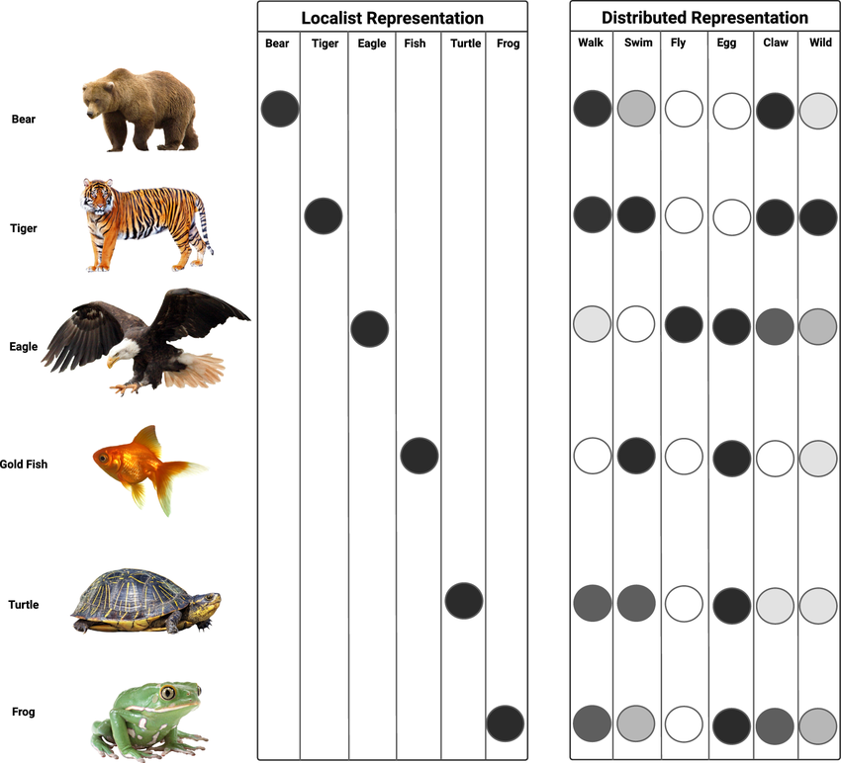
Pattern Recognition Algorithms
Localist vs. Distributed Representations
Localist codes are explicit and interpretable
Distributed codes are flexible and generalizable
Brains and networks often combine both
Notes:
Once connectionist models became widespread, researchers began asking: what exactly does a unit in one of these networks represent?
In some models, a single neuron corresponded to a single concept—this is called a localist code.
It’s an appealing idea because it’s easy to interpret: one cell for “grandmother,” another for “dog.”
It fits intuitively with how we like to think about meaning and memory.
But real brains, and most artificial networks, don’t work this way.
Instead, they use distributed representations: patterns of activity across many units jointly encode information.
Each unit contributes to many different representations, and no single neuron or node corresponds uniquely to any one concept.
This makes the system far more powerful.
It allows smooth generalization—similar inputs activate overlapping patterns—and it’s robust to damage or noise, since the information is shared.
Yet localist codes also have virtues: they’re easier to interpret and less prone to interference.
Biological systems often mix the two strategies—distributed population codes in sensory areas and more localist, concept-like cells in the hippocampus and temporal cortex.
The tension between these coding schemes remains central to both neuroscience and AI: it’s about the tradeoff between flexibility and clarity.

Slide 12
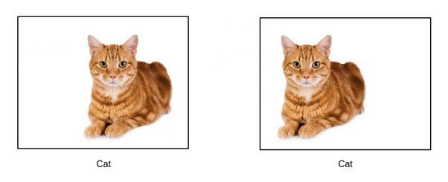
Pattern Recognition Algorithms
Hierarchical Representations and Abstraction
Recognizing the same thing in different forms
Layers capture structure from local to global
Composition enables invariance and generalization
Notes:
Even with distributed representations, a system still faces a key challenge: the same object rarely looks—or sounds—the same twice.
A cat viewed from the side, from above, or in shadow should still be recognized as the same animal.
A spoken word like “hello” must be recognized across speakers, accents, and volumes.
Recognition requires invariance—the ability to see through irrelevant variation.
The most powerful solution to this problem, discovered independently in psychology and machine learning, is hierarchy.
Hierarchical representations build complexity from simpler parts.
Early layers detect local features—edges, pitches, or phonemes—while later layers combine them into shapes, words, or objects.
Each layer abstracts over small differences, preserving what matters while discarding what doesn’t.
This idea is deeply intuitive: the world itself is hierarchically structured.
Parts form wholes, which form higher-order categories.
By mirroring that structure, hierarchical systems can recognize stability within change.
This principle, first articulated in human cognition, now lies at the core of every modern deep neural network.

Slide 13
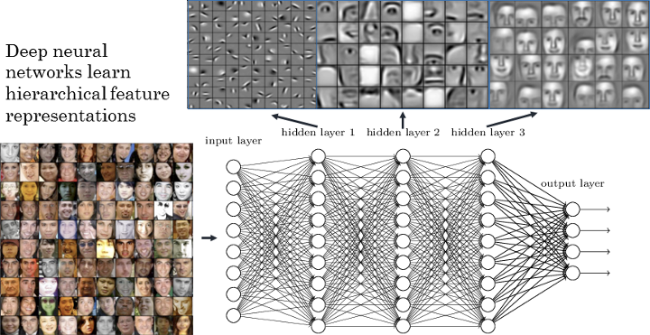
Pattern Recognition Algorithms
Convolutional Neural Networks (CNNs)
Networks that learn visual hierarchies automatically
Detect local features, build global representations
Inspired by—and similar to—the visual cortex
Notes:
To see how these ideas play out in practice,
we can look at one of the most influential architectures in modern AI:
convolutional neural networks, or CNNs.
CNNs were designed to solve visual recognition problems—
how to detect objects, faces, and scenes in all their variation.
They do this by layering many small, overlapping detectors:
early layers find edges and textures,
middle layers combine them into shapes and parts,
and higher layers recognize whole objects.
This structure isn’t just convenient—it’s biologically inspired.
In the visual cortex, neurons in early areas like V1 respond to oriented edges and local contrast,
while later areas like IT respond to entire objects,
regardless of position, size, or viewpoint.
CNNs capture the same principle computationally:
by stacking layers of local filters and pooling operations,
they achieve a form of translation invariance—
recognizing the same pattern no matter where it appears in the image.
Today, CNNs underpin many of the systems we interact with daily—
from face recognition and medical imaging to self-driving cars.
They represent one of the clearest examples of how a neurally inspired algorithm
can solve a complex problem that biology mastered long ago.

Slide 14
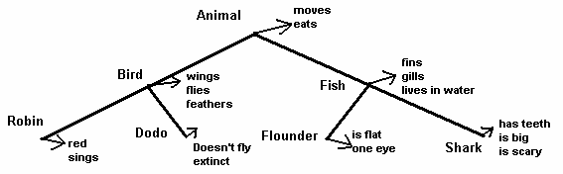
Pattern Recognition Algorithms
Hierarchies in Psychology
Collins and Quillian’s semantic hierarchies
Biederman’s recognition-by-components
Chomsky’s hierarchical syntax in language
Notes:
Psychology has long emphasized that cognition is organized hierarchically.
In the 1960s, Collins and Quillian proposed that human semantic memory is structured like a tree.
Concepts are nested within broader categories—“robin” under “bird,” “bird” under “animal.”
This allowed properties such as “has feathers” to be stored once, inherited efficiently, and applied across related concepts.
It was an early computational theory of generalization.
Irving Biederman’s recognition-by-components theory offered a similar principle for vision.
Objects, he argued, are represented as combinations of simple geometric parts called geons.
A coffee cup, for example, can be decomposed into a cylinder and a curved handle.
Recognizing an object means identifying its components and how they are arranged.
Around the same time, Noam Chomsky made a parallel argument about language.
He proposed that sentences are generated and understood through hierarchical syntactic structures—phrases nested within larger phrases, not just linear word sequences.
A sentence like “The dog that chased the cat ran away” cannot be understood by word order alone; it requires a tree-like structure connecting subjects, verbs, and clauses.
This hierarchical view of language mirrored the same insight seen in memory and vision: flexible, generative cognition depends on structured, compositional representations.

Slide 15
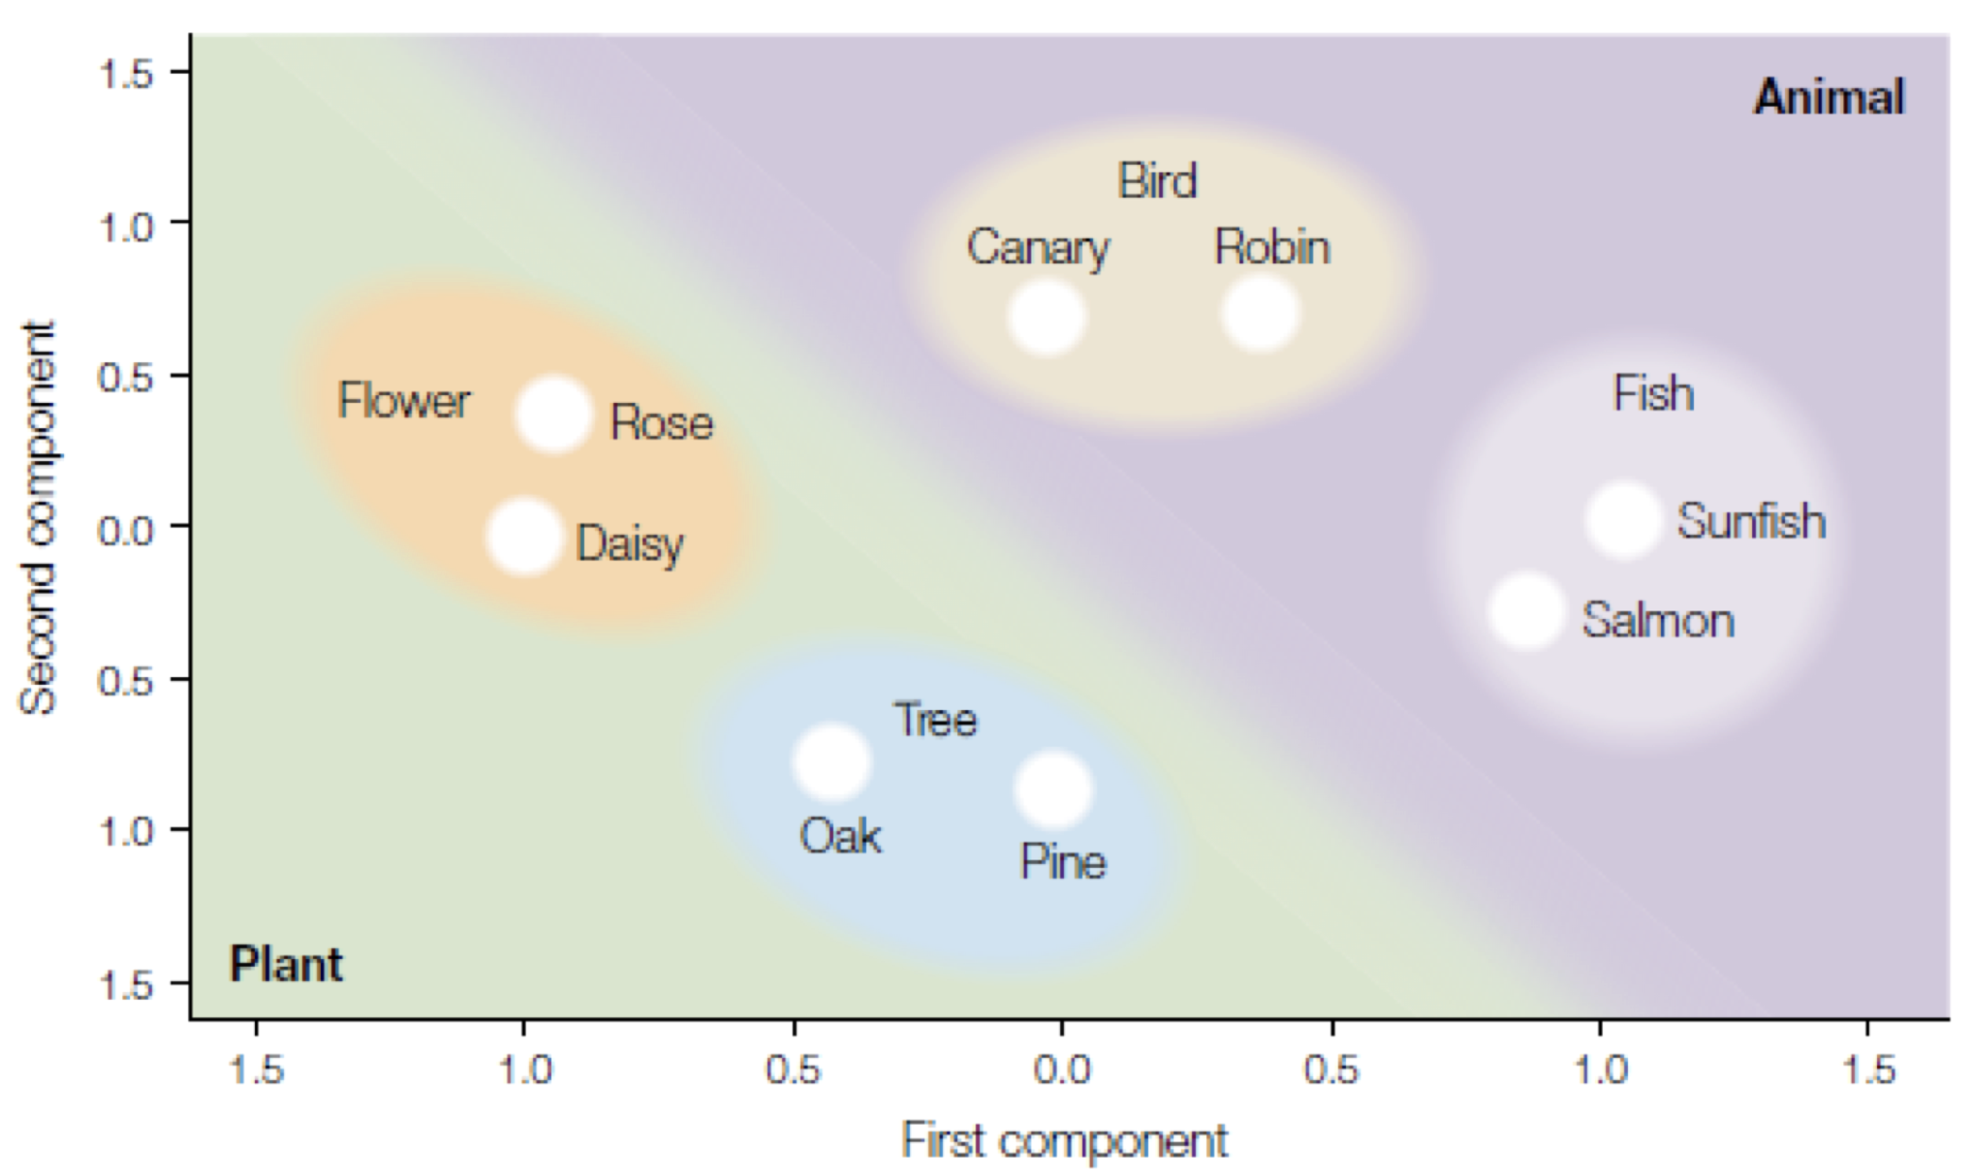
Pattern Recognition Algorithms
What Hierarchies Solve—and Don’t
Neural networks learn hierarchies implicitly, not explicitly
Implicit hierarchies support flexible generalization
But lack explicit structure for relations and meaning
Notes:
Neural networks learn hierarchies—but they do so implicitly.
Unlike a theory such as Chomsky’s grammar or Collins and Quillian’s semantic tree, no layer in a neural network literally stores the hierarchy.
It emerges through learning: early layers capture local features, later layers broader regularities, and the overall structure is distributed across many weights.
This implicitness has important strengths.
It allows the system to discover regularities automatically, without hand-crafted rules.
A convolutional or transformer network can learn hierarchical features directly from data, finding its own abstractions in a way that is flexible and adaptive.
This helps explain why such models can handle huge, noisy datasets and still find meaningful patterns.
But the lack of explicit hierarchical representation also brings costs.
Because the structure is not symbolically represented, the model often struggles to explain how elements are related.
It may capture that two words tend to appear together, but not that one governs the other syntactically.
Likewise, it may recognize patterns but fail to reason about relations or causes.
Humans, by contrast, represent hierarchy both implicitly—in perception—and explicitly—in concepts and language.
This explicitness supports flexible reasoning, analogy, and explanation—capacities that implicit systems only approximate.

Slide 16
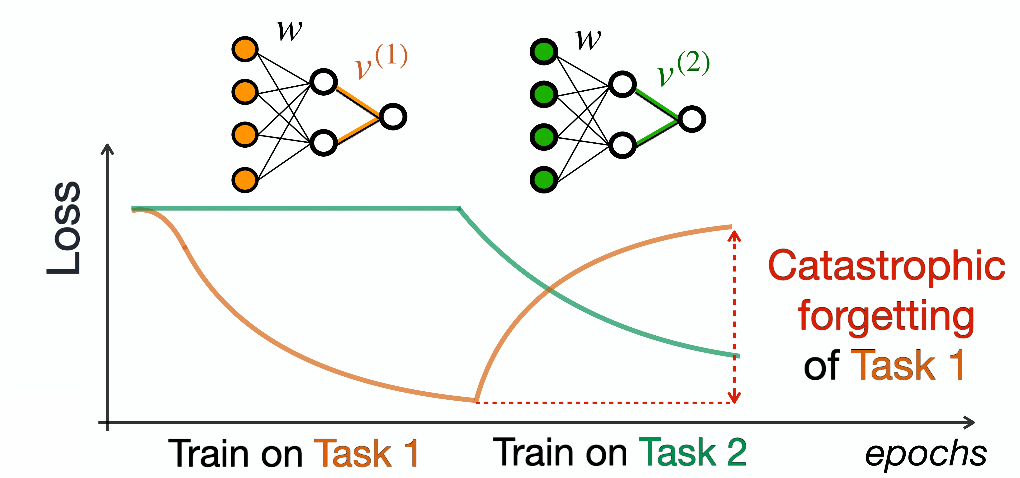
Pattern Recognition Algorithms
Continual Learning: Stability vs. Plasticity
Learning without forgetting is difficult
Catastrophic interference in neural networks
Arithmetic analogy: learning subtraction disrupts addition
Notes:
Learning is not just about gaining knowledge—it’s about keeping it.
Every adaptive system faces a tradeoff between plasticity and stability:
a system that adapts too quickly forgets the past,
and one that resists change can’t learn anything new.
This problem became famous in the late 1980s,
when Michael McCloskey and Neal Cohen demonstrated catastrophic forgetting.
They trained a neural network to perform addition—“2 + 3 = 5”—and then retrained it on subtraction—“5 – 2 = 3.”
Afterward, the network could no longer add correctly.
Learning the second task had overwritten what it knew about the first.
Brains face this same challenge.
They, too, must integrate new experiences without erasing old ones.
Yet humans rarely forget so catastrophically.
We can learn subtraction without losing addition, or pick up a new word without forgetting earlier ones.
This difference points to something fundamental:
human memory systems seem to manage the stability–plasticity balance in a way that current artificial systems do not.

Slide 17
Pattern Recognition Algorithms
h1
h2
x1
h1
x1
x2
x2
h2
Why Forgetting Happens
Distributed weights store overlapping knowledge
New learning reshapes existing representations
Brains mitigate this through consolidation and replay
Notes:
To understand why forgetting happens, we need to look at how neural networks represent what they know.
Instead of storing each fact in a separate place—like files in a cabinet—they use distributed representations.
Each concept or skill is encoded as a pattern of activation across many units, and each unit participates in many different representations.
This approach is powerful:
it allows the system to generalize smoothly, because similar inputs activate overlapping regions of the internal space.
But it also means that when the system learns something new,
it must adjust the same shared set of connection weights that encode its prior knowledge.
Imagine that each arithmetic problem—like “2 + 3 = 5” or “5 – 2 = 3”—is a point in a high-dimensional space.
Learning subtraction changes the geometry of that space,
bending and stretching the boundaries that used to define addition.
Even tiny shifts in those boundaries can ripple through the system,
distorting earlier knowledge in unpredictable ways.
The network hasn’t lost the old information—it’s just been moved, subtly and destructively, by the new learning.
If distributed representations make forgetting inevitable,
then the challenge is to manage interference rather than eliminate it.
Both biological and artificial systems have developed strategies to do just that.
One solution is replay.
In biological systems, this happens during sleep or rest:
the brain reactivates recent experiences, reinforcing older memories while integrating new ones.
Machine learning systems borrow this idea by rehearsing old data alongside new training examples—sometimes even generating synthetic “memories” to replay.
Another approach is modularity.
Instead of having one shared set of weights for everything,
different modules or subnetworks specialize in different tasks or contexts.
This reduces overlap and protects prior knowledge.
A third strategy is selective updating—
limiting how much important parameters can change.
In algorithms like Elastic Weight Consolidation,
weights that were critical for earlier tasks are allowed to move only slightly,
helping the network stay flexible without wiping out its past.
Together, these methods aim to strike the same balance that brains achieve naturally:
to keep learning new things without starting over each time.
The art of continual learning is the art of staying adaptive without falling apart.

Slide 18
Pattern Recognition Algorithms
Strengths of Modern Neural Networks
Learn complex nonlinear mappings
Discover hierarchical and distributed structure
Perform impressive pattern recognition tasks
Notes:
Despite their limitations, modern neural networks have achieved extraordinary successes.
They can learn complex, nonlinear mappings that were once thought to require explicit symbolic rules.
By stacking many layers of simple units, these systems can extract structure from raw data—discovering edges, shapes, words, and even abstract semantic relationships.
Their distributed representations allow them to generalize smoothly within the training space,
and their hierarchical organization enables powerful feature abstraction.
This combination lets them classify images, translate languages, and even generate coherent text with remarkable accuracy.
In a sense, today’s neural networks are proof of concept that many aspects of perception and recognition can emerge from relatively simple learning mechanisms—
when scaled up and trained on large datasets, they can match or even surpass human performance on narrow tasks.
But as we’ll see next, those successes also reveal what remains missing—
because the ways these systems succeed often expose the deeper ways in which they still fall short.

Slide 19
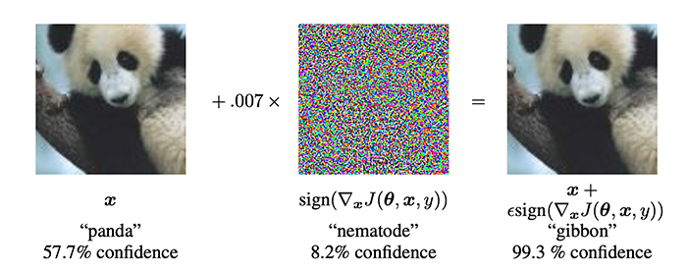
Pattern Recognition Algorithms
Adversarial Fragility
Tiny pixel changes cause confident misclassification
Dependence on shallow statistical cues
Humans remain robust to these distortions
Notes:
One of the clearest demonstrations of how neural networks differ from human perception comes from adversarial examples.
These are inputs that look almost identical to normal images—
a panda with just a few pixels changed—
but cause a neural network to classify it as something entirely different,
like a gibbon, with high confidence.
The key insight is that these systems rely heavily on the statistical texture of their inputs.
They are excellent at picking up subtle correlations in the data,
but those correlations may not reflect the true structure of the world.
Because of that, small perturbations that shift those surface statistics can completely mislead them.
Humans, by contrast, are remarkably robust.
We can recognize an object across lighting changes, occlusion, or even when it’s partially distorted.
Our perception is guided not just by raw features, but by an internal model of what things are—
their shapes, causal structure, and relationships to one another.
That difference highlights a central theme of this lecture:
neural networks can classify, but they do not necessarily understand.

Slide 20
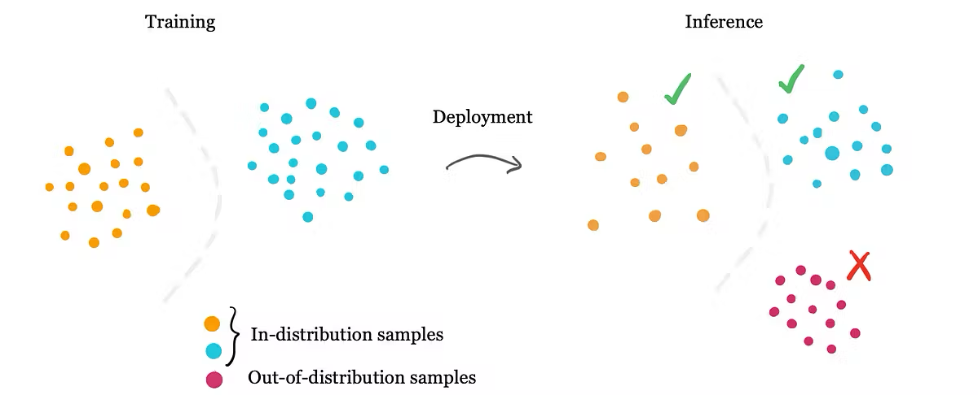
Pattern Recognition Algorithms
Out-of-Distribution Generalization
Performance collapses outside training conditions
Strong interpolation, weak extrapolation
Contrast with human flexibility across contexts
Notes:
Another major weakness of modern neural networks is out-of-distribution generalization—
their ability to handle data that falls outside the statistical range of what they were trained on.
A model that performs flawlessly on familiar images or sentences often fails catastrophically
when faced with slightly new conditions—
a novel viewpoint, an unfamiliar accent, or a sentence with an uncommon structure.
These systems are superb interpolators.
They can fill in gaps within the space of experiences they’ve seen before.
But they are poor extrapolators.
They struggle to extend what they’ve learned to truly new situations.
As Gary Marcus and others have argued,
this limitation reflects a deeper representational issue.
Neural networks depend on surface-level correlations,
not on structured, compositional rules that could support abstract generalization.
Humans, by contrast, can adapt to novelty with ease:
we recognize a creature we’ve never seen before as “some kind of bird,”
or see the analogy between the solar system and an atom.
We do not just fit data—we infer structure,
and that gives us a kind of flexibility that current models still lack.

Slide 21
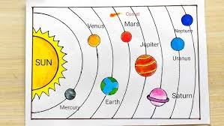
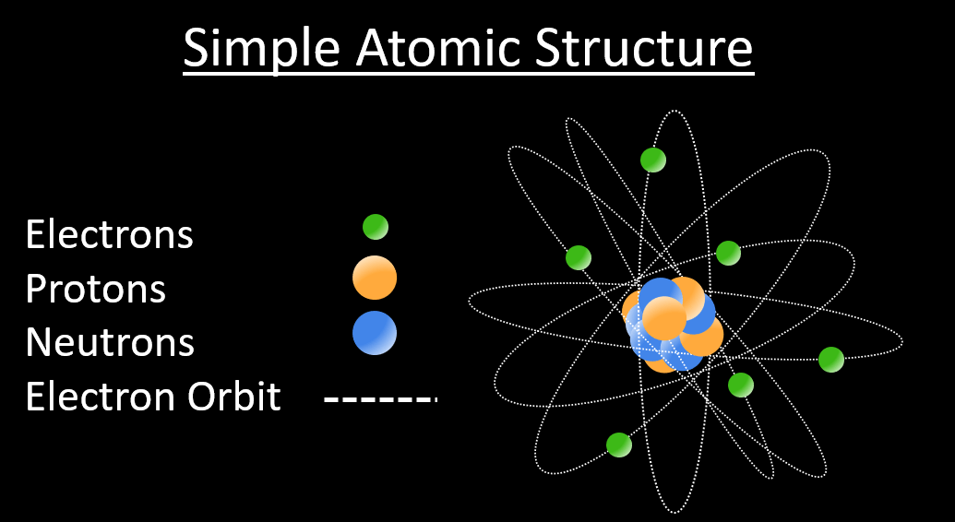
Pattern Recognition Algorithms
Relational and Causal Reasoning
Networks capture correlation, not relation or cause
Humans infer structure and intervene on the world
Embodied experience may be key to this gap
Notes:
Another way to see the limits of current neural networks is to look at how they reason about relationships and causes.
Human thinking is deeply relational: we don’t just notice co-occurrence; we represent how things relate to one another.
We can recognize that the structure of a solar system parallels that of an atom,
or that pushing harder causes something to move faster.
This ability to represent relations—not just features—is what allows us to generalize flexibly and reason by analogy.
Neural networks, by contrast, excel at picking up correlations but rarely encode relations explicitly.
They learn that two patterns tend to appear together,
but not that one depends on or causes the other.
As Judea Pearl and others have emphasized,
true understanding requires reasoning about interventions—what happens if we change something.
Humans, even as children, can do this intuitively:
we act, observe, and revise our understanding of the world through feedback and interaction.
The difference may not lie purely in architecture, but in experience.
Human learning unfolds in a world of actions and consequences,
rich with sensory and social feedback.
By contrast, most neural networks are trained passively—on static text or images—
without ever acting or perceiving.
That difference in embodiment and goal-directed learning
may be central to why humans infer relational and causal structure,
while current models mostly capture correlation.

Slide 22

Pattern Recognition Algorithms
Humans and Animals vs. ANNs
Fish, mice, and bees show robust recognition
Networks match some abilities but remain brittle
These gaps reveal both limits and insights
Notes:
To really understand where artificial systems stand,
it helps to compare them not just to humans but to other animals.
Even relatively simple creatures—like fish, bees, or mice—
display strikingly robust pattern-recognition abilities.
They can recognize objects or locations after only a few encounters,
adapt to changes in their environments,
and integrate information from multiple senses.
These capacities evolved long before the human brain,
suggesting that flexible pattern recognition is a deeply ancient achievement.
Artificial neural networks, in some ways, have reached this level of sophistication.
They can identify objects, voices, and patterns across noisy data with impressive accuracy.
In that sense, they give us a working model for how early perceptual intelligence might operate—
a form of learning grounded in pattern association and generalization.
But the comparison also exposes important limits.
Even simple animals can do things our best networks cannot:
they navigate unfamiliar spaces, adapt after injury, and learn from a handful of experiences.
Their learning is grounded in active exploration and feedback—
something our models still largely lack.
So while artificial systems capture parts of early perceptual intelligence,
they remain far more brittle and less adaptive than their biological counterparts.

Slide 23

Pattern Recognition Algorithms
Two Kinds of Missing Pieces
Missing fundamentals: embodiment, recurrence, integration, explicit structure
Later-evolving systems: causal, analogical, symbolic
Pattern recognition is only the foundation
Notes:
When we compare artificial neural networks to biological systems,
it’s useful to distinguish between two very different kinds of gaps.
Some gaps may reflect missing fundamentals—
things that even simple animals rely on for robust learning.
These include embodiment and feedback—
learning through direct interaction with the world rather than from static data—
and continual updating through exploration and goal-directed action.
Another likely missing piece is the explicit representation of structure.
Biological systems don’t just associate features; they represent how those features relate to each other.
A fish’s brain encodes not only that two shapes co-occur,
but also that one moves around the other, or that one event predicts another.
This ability to represent structure explicitly, rather than implicitly through correlations,
may be one of the fundamental distinctions between biological and artificial recognition systems.
Other gaps, however, probably reflect later-evolving capacities—
abilities layered on top of the perceptual core.
Causal reasoning, analogical mapping, and abstract thought
likely emerged through new neural systems that build on the foundation of pattern recognition,
not from altering the foundation itself.
From this evolutionary perspective, artificial neural networks may already capture
many of the perceptual and associative abilities that early animals possessed.
What remains is to understand how later systems—those supporting
structure, reasoning, and flexible generalization—
arose from that simpler substrate, both in brains and in machines.

Slide 24
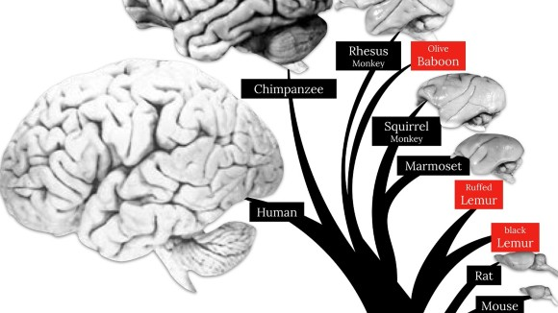
Pattern Recognition Algorithms
Lessons from Evolution
Early perceptual intelligence appears in both animals and ANNs
Later systems build on these foundations
Progress mirrors evolutionary layering
Notes:
If we step back and look at the larger picture,
the story of pattern recognition in both biology and AI
looks like a case of convergent evolution.
Early in evolutionary history, animals developed basic perceptual systems—
mechanisms for distinguishing food from poison, friend from foe,
and recognizing patterns across variation.
These systems were adaptive because they could generalize:
they captured the stable structure of the world while remaining flexible to change.
Even simple vertebrates, like fish, display these capacities.
Over time, evolution built more elaborate systems on top of this foundation.
In mammals and primates, new layers of neural circuitry allowed
for more abstract, relational, and goal-directed cognition—
culminating in humans, who can reason, plan, and imagine.
Artificial neural networks seem to follow a similar trajectory.
They’ve succeeded in reproducing something like early perceptual intelligence—
the ability to find stable patterns in noisy, variable data.
But they have not yet reached the levels of relational or causal understanding
that characterize later-evolving forms of intelligence.
This parallel suggests that current AI does not represent failure,
but rather a milestone along a deeper continuum—
one that recapitulates the same layering of capacities that occurred in biological evolution.

Slide 25
Pattern Recognition Algorithms
Recap
Neural networks solve many (but not all) of the problems a pattern recognition system needs to solve
Up Next
How brains implement feature extraction and learning
Neural architecture of stability and hierarchy
Notes:
Today, we explored how computational systems—
from the earliest connectionist models to modern deep networks—
address the core challenges of pattern recognition.
We saw how hidden layers, distributed representations, and hierarchical organization
allow networks to learn nonlinear mappings, build invariance, and generalize across variation.
But we also saw where these systems fall short—
how they remain fragile, narrowly tuned, and limited in their capacity
for relational and causal understanding.
These weaknesses remind us that pattern recognition, while powerful,
is only the foundation of intelligence.
In the next lecture, we’ll move from computation to implementation:
how the brain’s architecture realizes these same principles.
We’ll look at how neural circuits perform feature extraction,
how they balance stability with plasticity,
and how these mechanisms, refined through evolution,
form the biological groundwork for curiosity, exploration, and thought.

